Slide 1


Designing Mobile Applications with Xamarin
A best practices guide for optimum mobile cross platform development.

Slide 2
Who?
Jerel R Hass
@agies1
jhass@quicksolutions.com
Dan Steck

Slide 3
What is Xamarin?
Xamarin the product is about writing code in a single language (C#) to support the major development platforms and
Leveraging existing .Net Code
Giving a Native feel to your application
Using Native third-party libraries and frameworks
Accessing native APIs
Using my favorite IDE Visual Studio on Windows and Xamarin Studio on Mac
Xamarin the Company can be read about at the end of this http://xamarin.com/faq

Slide 4
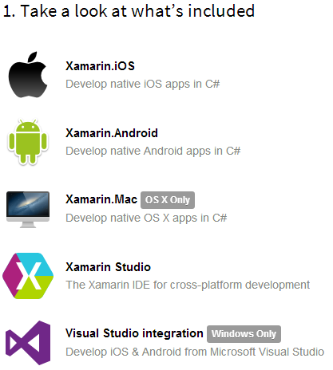
A Tour Around Xamarin
Downloading Xamarin - http://xamarin.com/
Looking for Hype - http://xamarin.com/tour
Need more help - http://docs.xamarin.com/

Slide 5
Why Native?
Performance
Native API Access
Native Look and Feel
Carry Over of Experience
You can still use Html!

Slide 6
How Xamarin Works

Slide 7
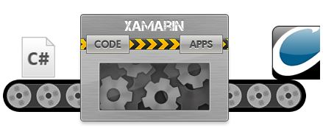
How Xamarin Works?
Put C# in one side and Applications pop out the other side, and get paid for it. Done!

Slide 8
How Xamarin Really Works
By compiling your C# into Native Binaries
By bundling your app with the Mono .Net Libraries
By Exposing a .Net like Native Layer

Slide 9

Building a Cross Platform Application
Mobile Project Log

Slide 10
What are we building? At Least Prototyping
Mobile Project Log
As a User we should be able to view a List of our Projects
As a User we should be able to view our Team
As a User we should be able to use the Camera to Upload “Status Reports”
As a User we should be able to use the Microphone to Record “Note”
As a User we should be able to store data locally to synchronize later

Slide 11
Laying out the Solution
Typical Architecture
XXXX.Core (Portable Class Library)
XXXX.Touch (MonoTouch iOS App)
XXXX.Droid (MonoDroid Android App)
XXXX.WP8 (Windows Phone 8 app)

Slide 12
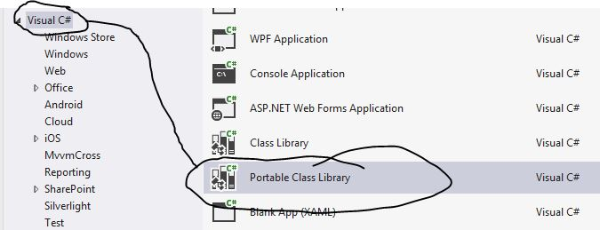
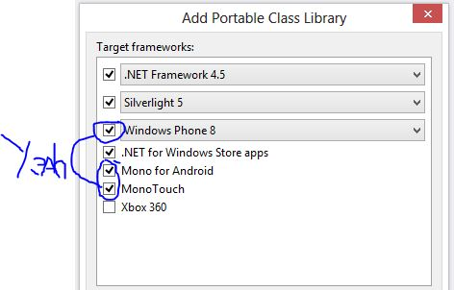

Adding the Portable Class Library

Slide 13
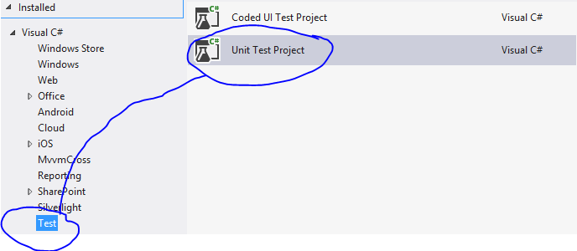

Adding a Test Library

Slide 14
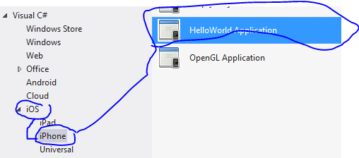
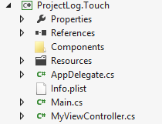
Adding the iOS Application

Slide 15
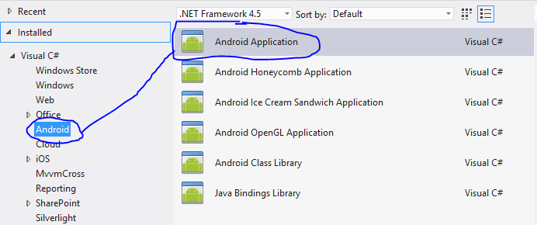
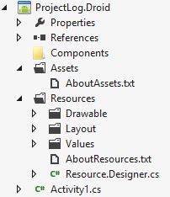
Adding the Android Application

Slide 16
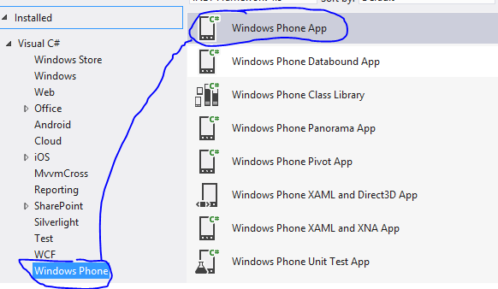
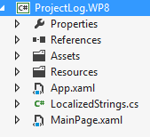
Adding the WP8 Application

Slide 17
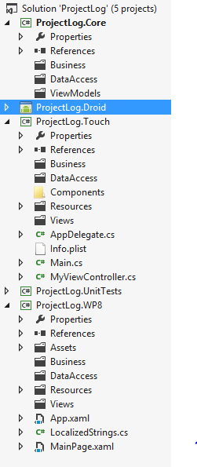
Structure Completed
We are ready to start writing some code.

Slide 18
Ensure Everything is Ready
Proper preparation

Slide 19
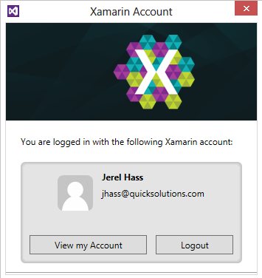
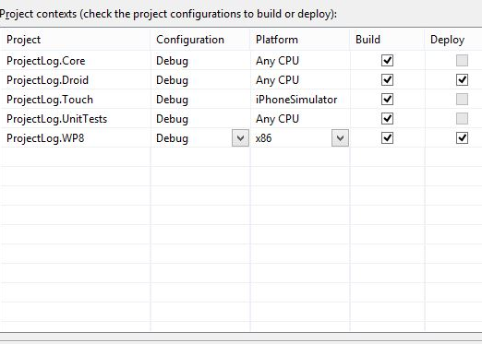
Pre-Dev Check List
Xamarin Account is Ready
Solutions are Deploy Ready
Emulators/Devices are Awake
If Using Devices are they provisioned?

Slide 20
Building the Business
Here comes the fun

Slide 21
Separations of Concerns
The Back End
Proxies,
Services,
Controllers oh my…

Slide 22
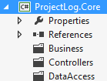
One of Many Architectures
Simple Architecture
Future:
IoC
Binding

Slide 23
It Gets the Datas
Lets Build
A Test
A Controller
A Proxy

Slide 24
Plug the Controller in
Lets add the Controller into the Pre-created Project views

Slide 25
Building Native Views
Time to Get Designee

Slide 26
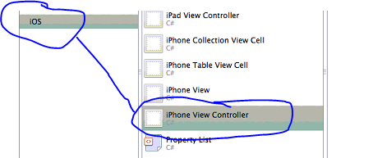
Creating an iOS View
2 Choices
In Code (Crazy, using the Dialog Builder may be faster)
Xcode Xib file, creates the controller to (Not Crazy)
The Plan
Switch to the Mac
Open Xamarin Studio
Create a Generic iOS View
Build the View In Xcode

Slide 27
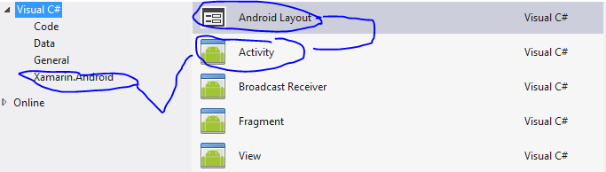
Creating an Android View
The Plan
Create an Activity
Create a Layout File
Build
Bind the two together

Slide 28
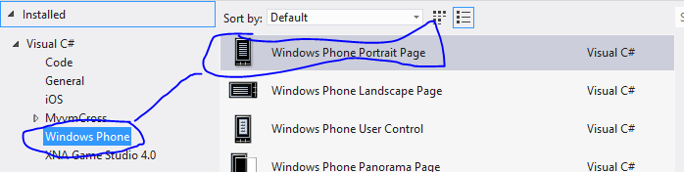
Creating a WP8 View
The Plan
Create a new WP8 view
Whistle a tune, to fill time

Slide 29
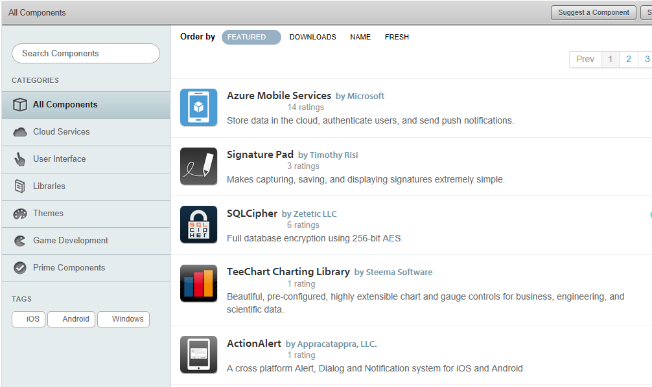
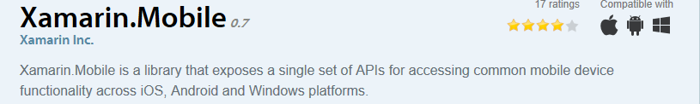

Adding Components

Slide 30
Adding Components Cont…
Why?
Wrap Native Code, make a more neutral API
Offer Productivity Add-in
Normal Third Party Reasons

Slide 31
Native APIs
Keep Platform specifics on that Platform
Avoid Compiler Directives
Wrap Native calls for better testing

Slide 32
Neutralizing Platform Differences with MVVMCross
Now for the Good Stuff

